Slide 1
Lead Scoring Case Study
Jeetendra Kumar Pal

Slide 2


Agenda
A
Introduction
Primary goals
Process
ROC Curve And Optical Cut-Off Probability
Summary

Slide 3
Introduction
Lead Conversion Process - Demonstrated as a funnel As you can see, there are a lot of leads generated in the initial stage (top) but only a few of them come out as paying customers from the bottom. In the middle stage, you need to nurture the potential leads well (i.e. educating the leads about the product, constantly communicating etc. ) in order to get a higher lead conversion

Slide 4
Primary goals
As a part of the Lead Scoring case study, I have been presented with the details how the company X Education pursues customer leads from various sources and tries to convert them to potential customers. The current conversion rate is quite low at 30%. So we have been tasked to analyze the data and come up with a model which can make predictions to the order to 80% Lead conversion.

Slide 5
Process
For this, we have proceeded with the basic analysis of the given data set.
1-Identifying the columns based on Data Dictionary.
2-Elimination invalid / redundant columns.
3-Removing records with > 30% missing data.
4-Imputing few columns with missing data .
5-Identifying the potential data columns which can factor in for accurate prediction.
6-Identifying the relationship and distribution of column data using graphs.
7-Removing the outliers in numerical variables.
8-Plotting heat map to see the correlations .

Slide 6
Later, we proceeded with encoding the categorical data into Dummy variables so that we can easily convert them into features which can be fed into a Model used for predictions.
The Others, Unknown values that transformed into columns are dropped from the Dummy columns.
The data is then split into training and test data in ratio of 70:30.
The training data is scaled to avoid any disparities in magnitude of the data values impacting the model prediction.
The training data is fed into a Generalized Linear Model (GLM).
The ineffective variables are eliminated using RFE and VIF.
We are then left with 14 variables + 1 constant which has been able to predict the training data set at more than 80% accuracy and precision.
The same model has been applied to test data set after the test data has been scaled. And we have also observed more than 80% accuracy & precision there as well.

Slide 7
ROC Curve And Optical Cut-Off Probability
ROC Curve represents how much the model is able to distinguish between the classes.
AUC – Area under the curve represents that it is distinguishing the 1’s and 0’s correctly
On plotting the ROC curve for our data we see that, AUC is around 0.88 which means at around 88% of the times, the model is able to distinguish the 1’s as 1’s and 0’s as 0’s.
AUC of 0.88 is found to be very stable model.
When we plot the sensitivity, accuracy and specificity of the model together, the optimal cut off point is found to be at 0.35. This means that at 35% probability, the sensitivity and specificity are found to be balanced.
With probability = 0.35 , we predict y-values with XTrain, in such a way that, any conversion prob > 35% is said to be converted to a lead.

Slide 8
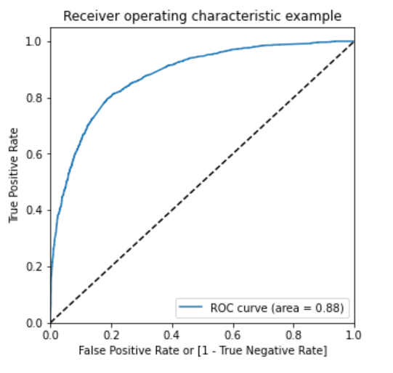
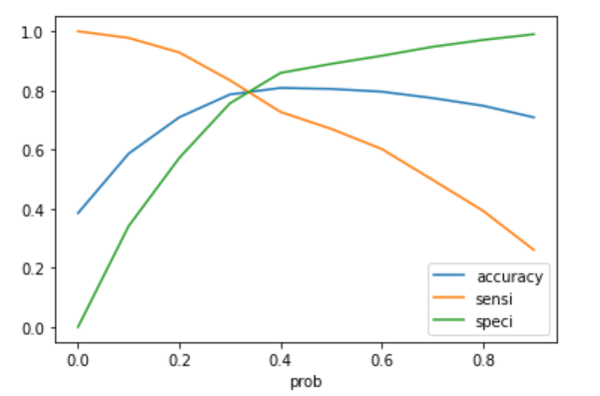

Slide 9
Summary
1-The company should make calls to the leads coming from the lead sources "Welingak Websites" and "Reference" as these are more likely to get converted.
2-The company should make calls to the leads who are the "working professionals" as they are more likely to get converted.
3-The company should make calls to the leads who spent "more time on the websites" as these are more likely to get converted.
4-The company should make calls to the leads coming from the lead sources "Olark Chat" as these are more likely to get converted.
5-The company should make calls to the leads whose last activity was SMS Sent as they are more likely to get converted.
6-The company should not make calls to the leads whose last activity was "Olark Chat Conversation" as they are not likely to get converted.

Slide 10
Thank you
Jeetendra Kumar Pal
jeetendrapal121@gmail.com

